Slide 1
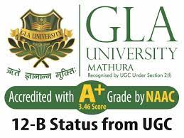
BCA Ist Semester
PROBLEM SOLVING USING COMPUTER
Course Code: BCAC 0018
Presented by:
Mr. SANTOSH KUMAR SWARNKAR
Dept. Of CEA
GLA University, Mathura

Slide 2
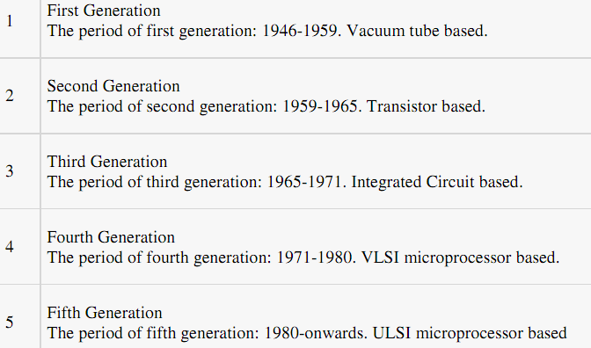
Generation of Computers

Slide 3
First Generation (1946 to 1959):
Using Vacuum Tubes
The first generation of computers used vacuum tubes for circuitry and magnetic drums for memory.
The input to the computer was through punched cards and paper tapes.
The output was displayed as printouts.
The instructions were written in machine language.
Machine language uses 0s and 1s for coding of the instructions.

Slide 4
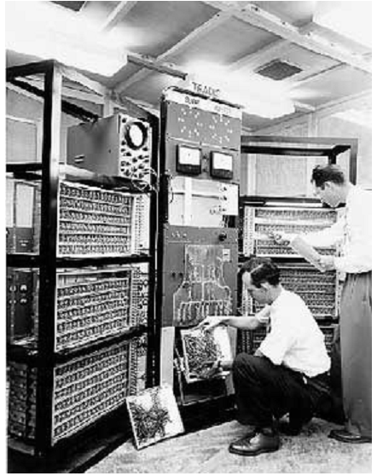

Slide 5
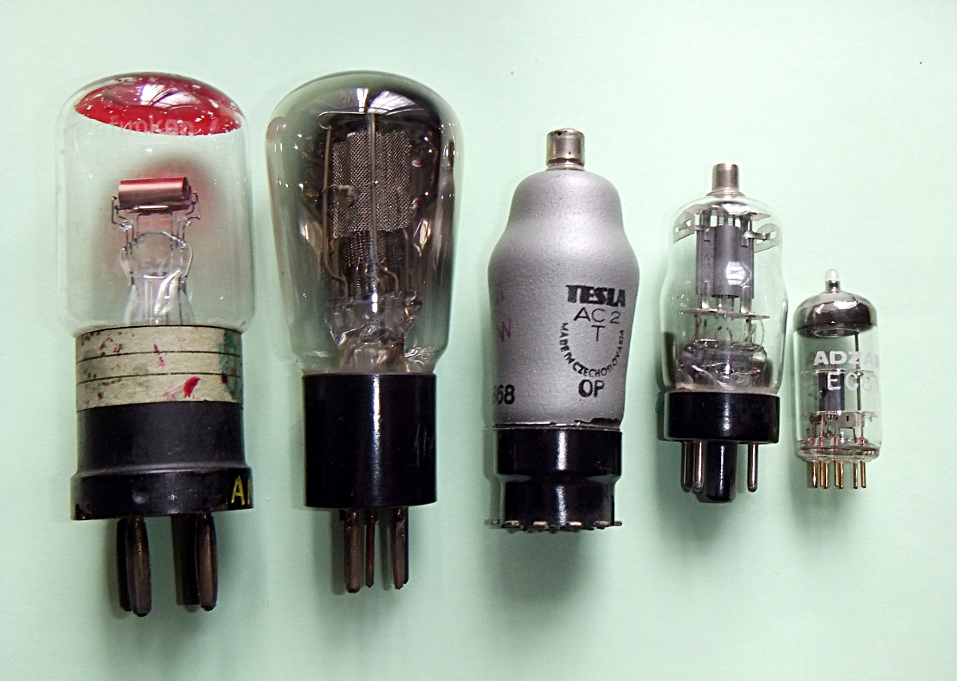
Vacuum Tubes

Slide 6
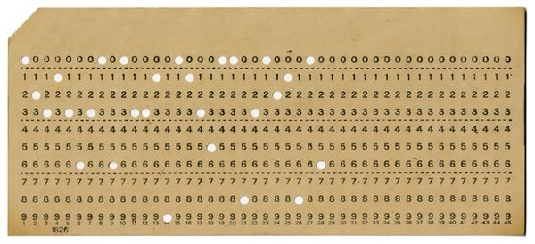
Punch card

Slide 7
The first generation computers could solve one problem at a time.
These computers were very big in size and required a large room for installation.
UNIVersal Automatic Computer (UNIVAC),
Electronic Numerical Integrator And Calculator (ENIAC), and
Electronic Discrete Variable Automatic Computer (EDVAC).

Slide 8
Second Generation (1959 to 1965):
Using Transistors
Transistors replaced the vacuum tubes of the first generation of computers.
Transistors allowed computers to become smaller, faster, cheaper, energy efficient and reliable.
They used magnetic tapes and magnetic disks for secondary storage.
The input was still through punched cards and the output using printouts.

Slide 9
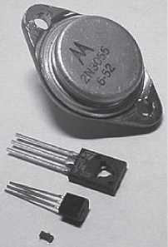
Transistors
Figure 1.5 Transistors

Slide 10
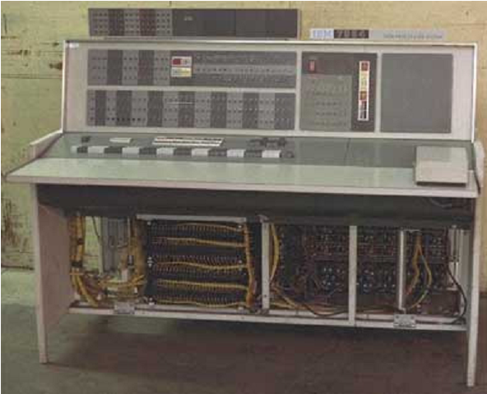

Slide 11
They used the concept of a stored program, where instructions were stored in the memory of computer.
The instructions were written using the assembly language.
Assembly language uses mnemonics like ADD for addition and SUB for subtraction for coding of the instructions.
PDP-8, IBM 1401 and CDC 1604

Slide 12
END

